Slide 1
Map Chart
Using Excel

Slide 2
Show in the USA Map which food sells the highest in each city.

Slide 3
Dataset
The data has 3 columns:
Food Items.
City.
Order value.
and 100 rows.

Slide 4
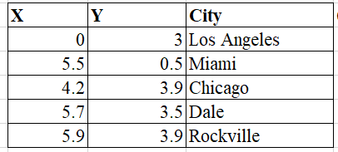
Defined the X and Y axis
I inserted the scatter plot chart in an empty cell.
I inserted the USA map.
I defined the X and Y axis based of the city location.

Slide 5
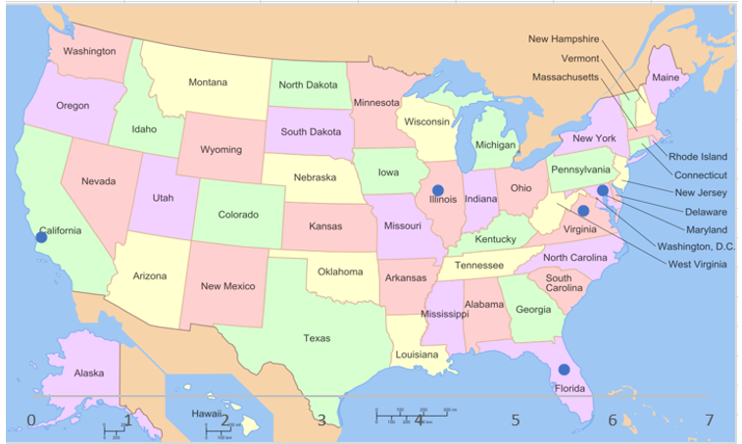
Inserted the X and Y axis into the map

Slide 6
Added the 3rd dimension
Now that I have cities on the map. I can add the third dimension “Order Value”.
It’s going to depend on foods items.
For that, I have to create a drop down list on food Items using the data validation.

Slide 7
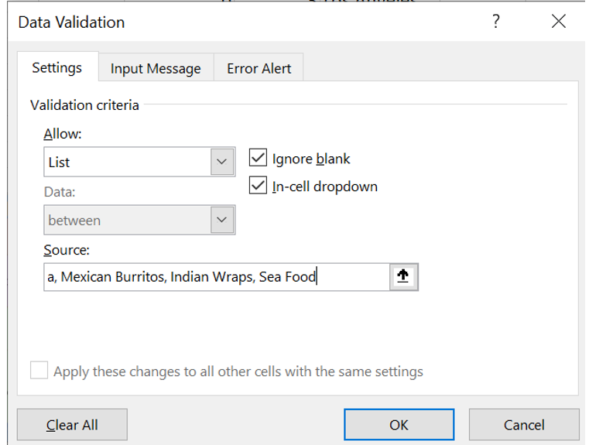
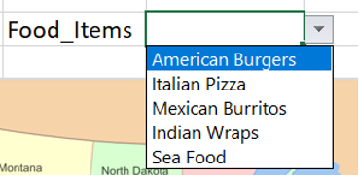
Data validation

Slide 8
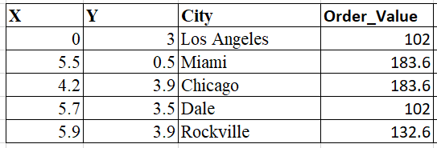

Total Order value
I calculated the total Order Value based on city and foods Items.
For that I used the sumIfs function.
The order value will change based on the foods selection.

Slide 9
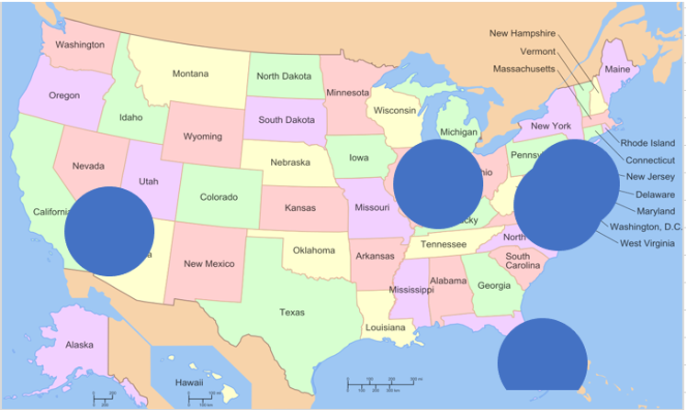
Added the order value in the Chart
To do that, I changed the chart from scatterplot to Bubble chart.

Slide 10
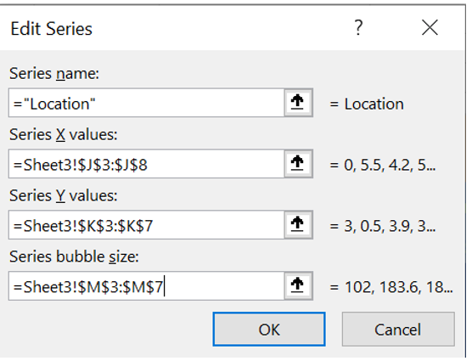
Added the order value in the Chart
I inserted the data into the map using “Select Data” : Bubble Size Value = Order Value

Slide 11
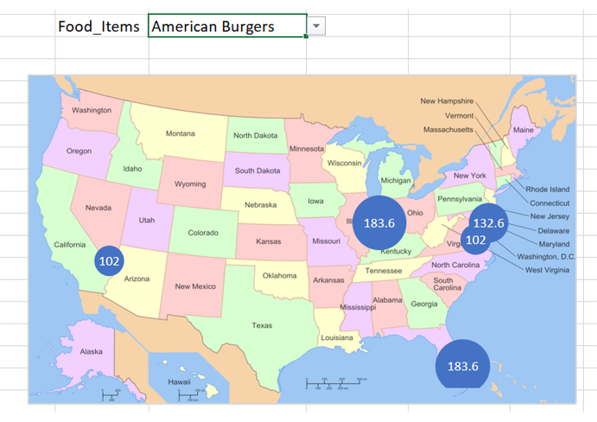
Highest Food Item sold in each city

Slide 12
Highest food sold in each city
The map is showing the total American Burgers sold in each city.
And the highest sold can be found in Miami and Chicago
To have the total sales more visible, I calculated the highest food sells using the combination of IF and Max function.
I inserted the data into the map as well
Which gave the result below.

Slide 13
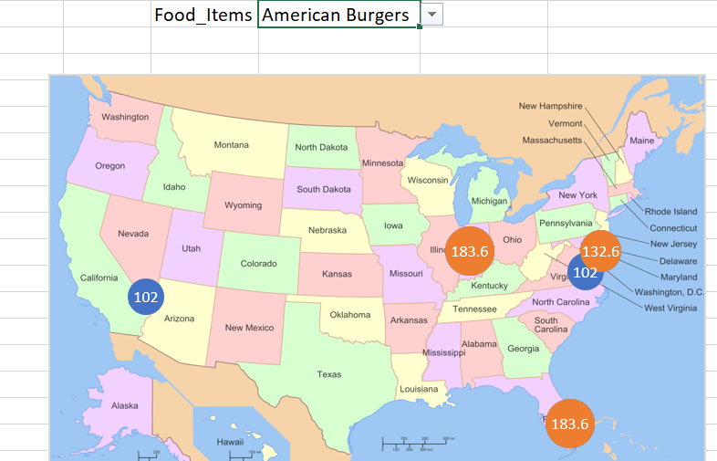
Highest food Item sold in each city

Slide 14
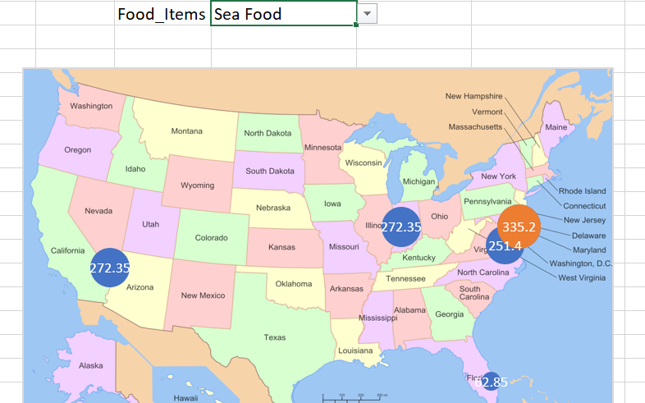
Highest food Item sold in each city
Overall,
Based on the USA Map, the food item that has the highest sell in each city is “Sea Food”

Slide 15
Thanks for Reading!
Don’t forget to comments and add more insights

